Slide 1


NEXT GEN EMPLOYABILITY PROGRAM
CREATING A FUTURE-READY WORKFORCE
Student Name :
Aditya Malviya
Student ID :
STU63e471106b64a1675915536
Mobile No:
9131355900
Mail ID:
adityamalviya161@gmail.com
College Name :
Gyan Ganga Institute of Technology and Sciences

Slide 2
CAPSTONE PROJECT SHOWCASE
Project Title
Data Analysis on Unicorn Businesses
Abstract | Problem Statement | Project Overview | Proposed Solution | Technology Used | Modelling & Results | Conclusion | Q&A

Slide 3
Abstract
1
Exploration of Unicorn Landscape
2
Identification of Success Factors
3
Data-driven Insights
4
Contribution to Understanding

Slide 4


Problem Statement
Unicorn businesses, those valued at over $1 billion, are becoming more common, but we don't fully understand what makes them successful. Using Power BI, we're going to dig into their data to figure out what factors contribute to their success. This will help investors, entrepreneurs, and policymakers make better decisions in the world of high-growth startups.

Slide 5

Project Overview
Our project focuses on analyzing unicorn businesses, which are startups valued at over $1 billion. Using Power BI, we'll dive into their data to understand what makes them successful. We'll explore things like their industries, where they're located, how they grow, and what factors contribute to their success. By doing this, we aim to provide valuable insights that can help investors, entrepreneurs, and policymakers make smarter decisions in the world of high-growth startups.

Slide 6
Proposed Solution
Our solution involves using Power BI to analyze unicorn businesses' data. We'll look at things like their industries, funding, and growth. With Power BI's tools, we'll find out what makes these companies successful. Then, we'll create easy-to-understand dashboards to show our findings. This will help investors, entrepreneurs, and policymakers make smarter decisions about high-growth startups.

Slide 7
Technology used
Power BI

Slide 8
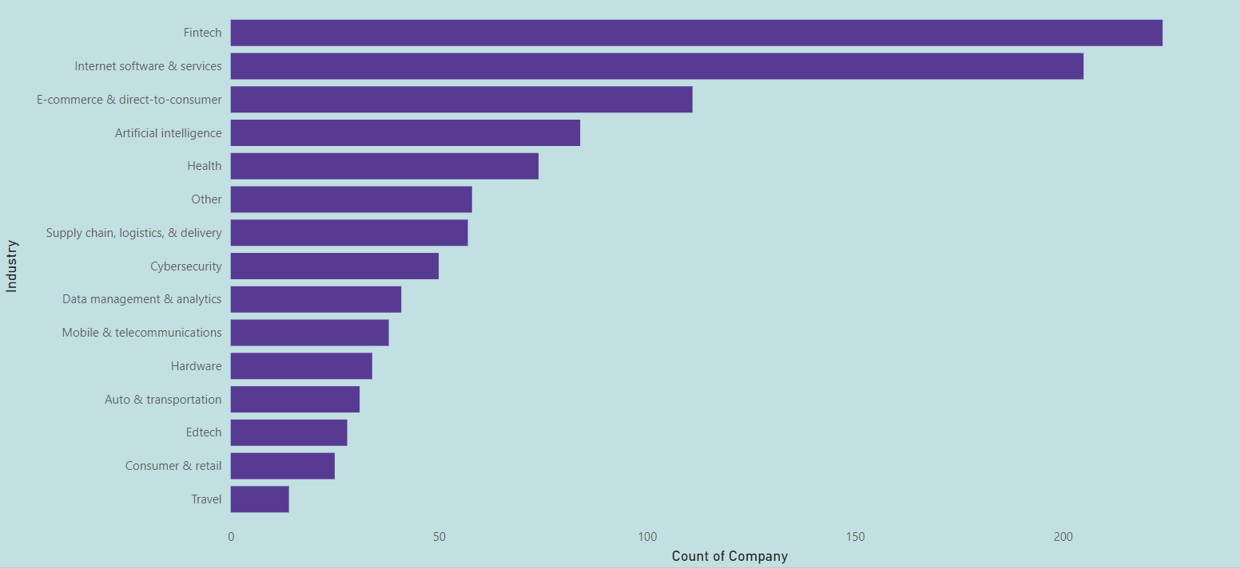
Modelling & Result
Count of Company by Industry

Slide 9
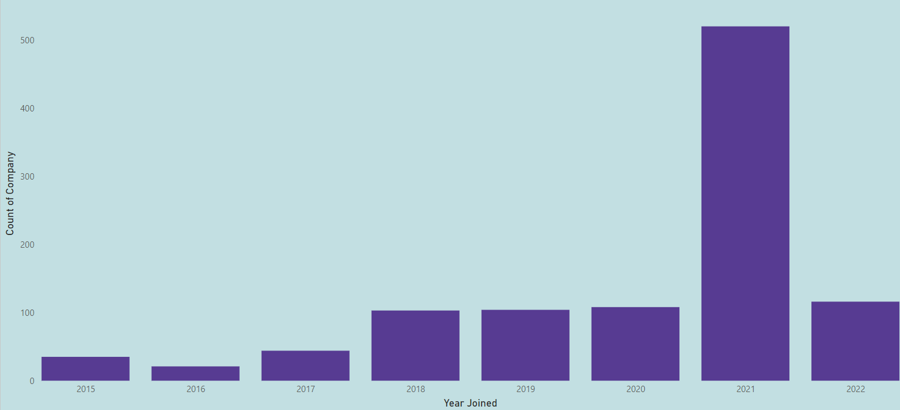
Modelling & Result
Count of Company by Year Joined

Slide 10
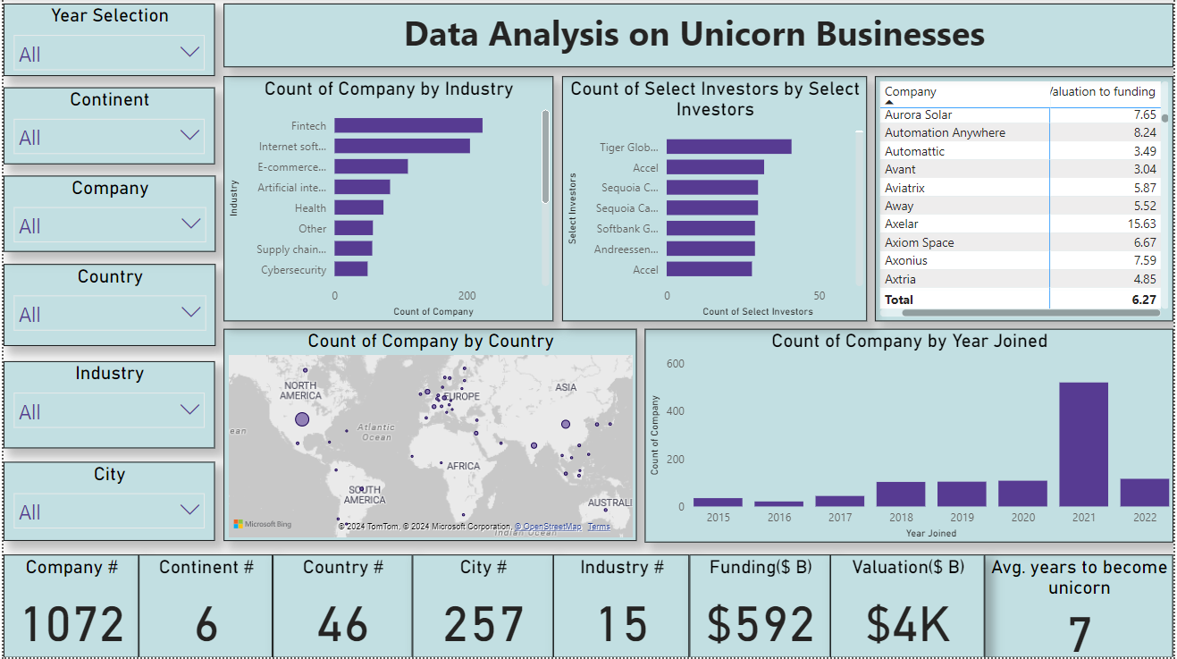
Modelling & Result

Slide 11

Conclusion
In conclusion, our analysis using Power BI has provided valuable insights into the world of unicorn businesses. We've identified key factors contributing to their success and presented our findings through interactive dashboards. By understanding these insights, stakeholders can make informed decisions in navigating the landscape of high-growth startups. Moving forward, continued analysis and adaptation will be crucial in staying ahead in this dynamic environment.

Slide 12


Notes:
Thank You !!

